Slide 1
Dashboard profit
File created on: 6/30/2022 10:27:38 PM

Slide 2


Slide 3
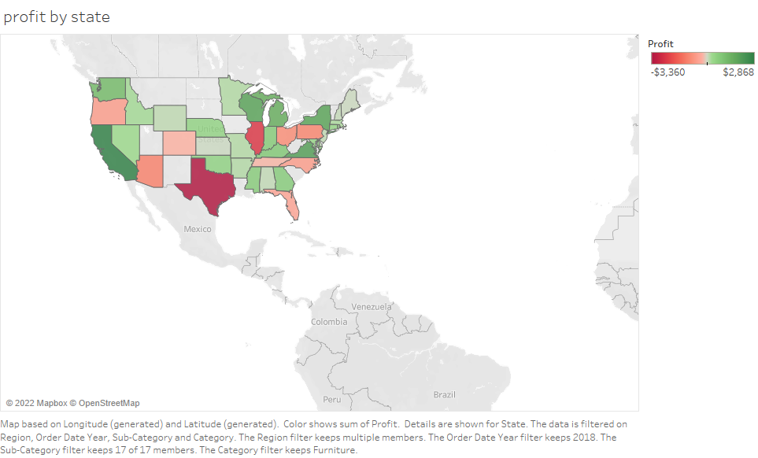

Slide 4
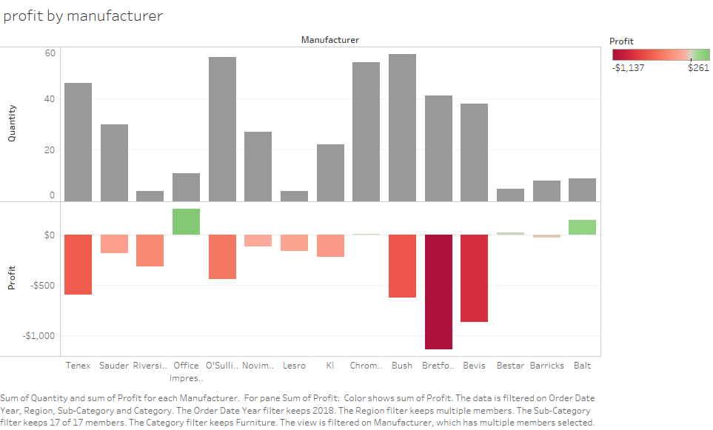

Slide 5
